Slide 1
Lecture 13: Recurrent Neural Networks

Slide 2
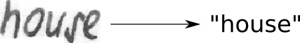
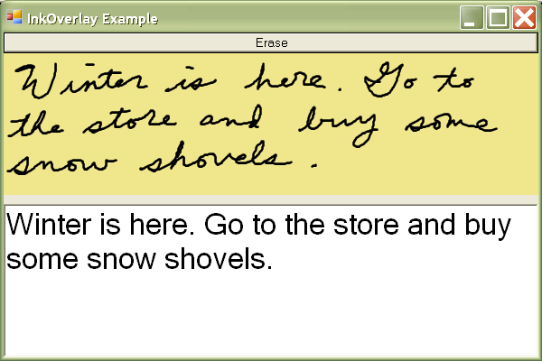
Sequence Modeling: Handwritten Text Translation
Input : Image
Output: Text
https://towardsdatascience.com/build-a-handwritten-text-recognition-system-using-tensorflow-2326a3487cd5
Notes:
http://www.research.att.com/articles/featured_stories/2012_10/201210_StorEbook.html?fbid=dKukkzHjbdh
https://devblogs.nvidia.com/parallelforall/introduction-neural-machine-translation-gpus-part-3/
http://www.ironpython.info/index.php?title=Basic_Handwriting_Recognition

Slide 3
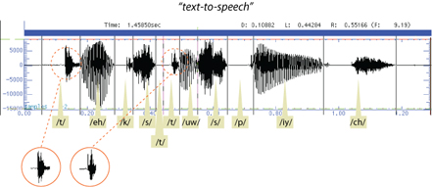
Sequence Modeling: Text-to-Speech
Input : Audio
Output: Text

Slide 4
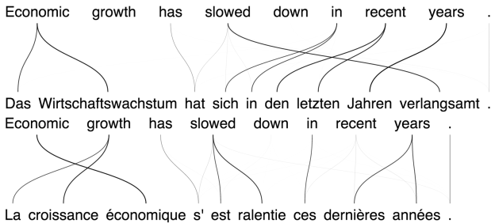
Sequence Modeling: Machine Translation
Input : Text
Output: Translated Text

Slide 5
Rapping-neural-network
https://github.com/robbiebarrat/rapping-neural-network

Slide 6
Outline
Why RNNs
Main Concept of RNNs
More Details of RNNs
RNN training
Gated RNN

Slide 7
Outline
Why RNNs
Main Concept of RNNs
More Details of RNNs
RNN training
Gated RNN

Slide 8
What can my NN do?
Training: Present to the NN examples and learn from them.
NN
[George, Mary, Tom, Suzie]

Slide 9
What can my NN do?
Prediction: Given an example
NN
George
NN
Mary

Slide 10
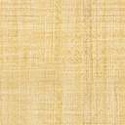
What my NN can NOT do?
WHO IS IT?
?

Slide 11
Learn from previous examples
Time

Slide 12
Recurrent Neural Network (RNN)
NN
George

Slide 13
Recurrent Neural Network (RNN)
I have seen George moving in this way before.
NN
George
RNNs recognize the data's sequential characteristics and use patterns to predict the next likely scenario.

Slide 14
Recurrent Neural Network (RNN)
WHO IS HE?
I do not know. I need to know who said that and what he said before. Can you tell me more?
He told me I could have it
Our model requires context - or contextual information - to understand the subject (he) and the direct object (it) in the sentence.

Slide 15
RNN – Another Example with Text
WHO IS HE?
- Hellen: Nice sweater Joe.
- Joe: Thanks, Hellen. It used to belong to my brother and he told me I could have it.
I see what you mean now! The noun “he” stands for Joe’s brother while ”it” for the sweater.
After providing sequential information, the model understood the subject (Joe’s brother) and the direct object (sweater) in the sentence .

Slide 16
Sequences
We want a machine learning model to understand sequences, not isolated samples.
Can MLP do this?
Assume we have a sequence of temperature measurements and we want to take 3 sequential measurements and predict the next one
features
1
2
3
4
5
6
7
…
35
32
45
48
41
39
36
…
samples

Slide 17
Sequences
We want a machine learning model to understand sequences, not isolated samples.
Can MLP do this?
Assume we have a sequence of temperature measurements and we want to take 3 sequential measurements and predict the next one
features
1
2
3
4
5
6
7
…
35
32
45
48
41
39
36
…
1
2
3
4
35
32
45
48
samples

Slide 18
Sequences
We want a machine learning model to understand sequences, not isolated samples.
Can MLP do this?
Assume we have a sequence of temperature measurements and we want to take 3 sequential measurements and predict the next one
features
1
2
3
4
5
6
7
…
35
32
45
48
41
39
36
…
1
2
3
4
35
32
45
48
2
3
4
5
32
45
48
41
samples

Slide 19
Sequences
We want a machine learning model to understand sequences, not isolated samples.
Can MLP do this?
Assume we have a sequence of temperature measurements and we want to take 3 sequential measurements and predict the next one
features
1
2
3
4
5
6
7
…
35
32
45
48
41
39
36
…
1
2
3
4
35
32
45
48
2
3
4
5
32
45
48
41
3
4
5
6
45
48
41
39
samples

Slide 20
Sequences
We want a machine learning model to understand sequences, not isolated samples.
Can MLP do this?
Assume we have a sequence of temperature measurements and we want to take 3 sequential measurements and predict the next one
features
1
2
3
4
5
6
7
…
35
32
45
48
41
39
36
…
1
2
3
4
35
32
45
48
2
3
4
5
32
45
48
41
3
4
5
6
45
48
41
39
samples

Slide 21
Windowed dataset
This is called overlapping windowed dataset, since we’re windowing observations to create new.
We can easily do using a MLS:
3
1
10 ReLU
10 ReLU
1 ReLU
But re-arranging the order of the inputs like:
3
1
2
4
45
35
32
2
4
3
5
32
48
45
5
4
3
6
41
48
45
will produce the same results

Slide 22
Why not CNNs or MLPs?
MLPs/CNNs require fixed input and output size
MLPs/CNNs can’t classify inputs in multiple places

Slide 23
Windowed dataset
What follows after: ‘I got in the car and’ ?
drove away
What follows after: ‘In car the and I’ ?
Not obvious it should be ‘drove away’
The order of words matters. This is true for most sequential data.
A fully connected network will not distinguish the order and therefore missing some information.

Slide 24
Outline
Why RNNs
Main Concept of RNNs
More Details of RNNs
RNN training
Gated RNN

Slide 25
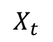
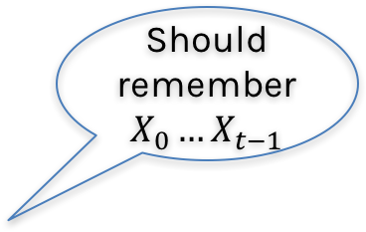
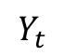
Memory
Somehow the computational unit should remember what it has seen before.
$$Y_{t}$$
Should remember $X_{0}…X_{t−1}$
Unit
$$X_{t}$$

Slide 26
Memory
Somehow the computational unit should remember what it has seen before.
$$Y_{t}$$
Unit
Internalmemory
$$X_{t}$$

Slide 27
Memory
Somehow the computational unit should remember what it has seen before.
We’ll call the information the unit’s state.
$$Y_{t}$$
RNN
Internalmemory
$$X_{t}$$

Slide 28
Memory
In neural networks, once training is over, the weights do not change. This means that the network is done learning and done changing.
Then, we feed in values, and it simply applies the operations that make up the network, using the values it has learned.
But the RNN units are able to remember new information after training has completed.
That is, they’re able to keep changing after training is over.

Slide 29
Memory
Question: How can we do this? How can build a unit that remembers the past?
The memory or state can be written to a file but in RNNs, we keep it inside the recurrent unit.
In an array or in a vector!
Work with an example:
Anna Sofia said her shoes are too ugly. Her here means Anna Sofia.
Nikolas put his keys on the table. His here means Nikolas

Slide 30
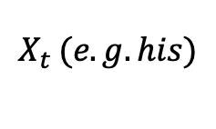
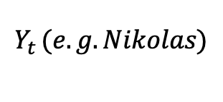
Memory
Question: How can we do this? How can build a unit that remembers the past?
The memory or state can be written to a file but in RNNs, we keep it inside the recurrent unit.
In an array or in a vector!
$$Y_{t }(e.g. Nikolas)$$
RNN
Memory
RNN
Memory
$$X_{t }(e.g. his)$$

Slide 31
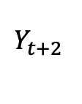
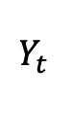
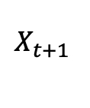
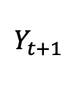
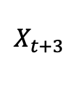
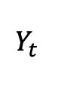
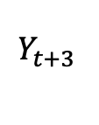
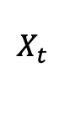
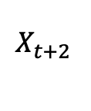
Building an RNN
$$Y_{t }$$
Memory
RNN
Memory
$$X_{t }$$
$$Y_{t }$$
$$Y_{t+1 }$$
$$Y_{t+2 }$$
$$Y_{t+3 }$$
RNN
RNN
Memory
RNN
Memory
RNN
Memory
Memory
Memory
$$X_{t }$$
$$X_{t+1 }$$
$$X_{t+2 }$$
$$X_{t+3 }$$

Slide 32
Outline
Why RNNs
Main Concept of RNNs
More Details of RNNs
RNN training
Gated RNN

Slide 33
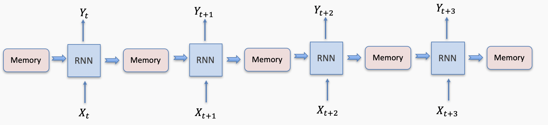
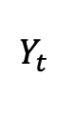
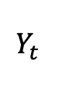
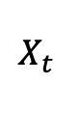
Structure of an RNN cell
$$Y_{t }$$
$$Y_{t }$$
output
weight
update
weight
RNN
State
RNN
State
input
weight
$$X_{t }$$
$$X_{t }$$

Slide 34
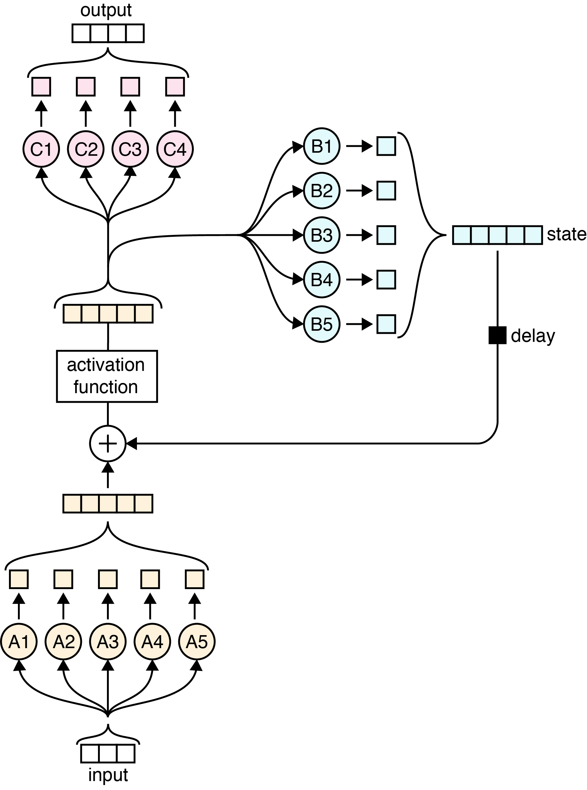
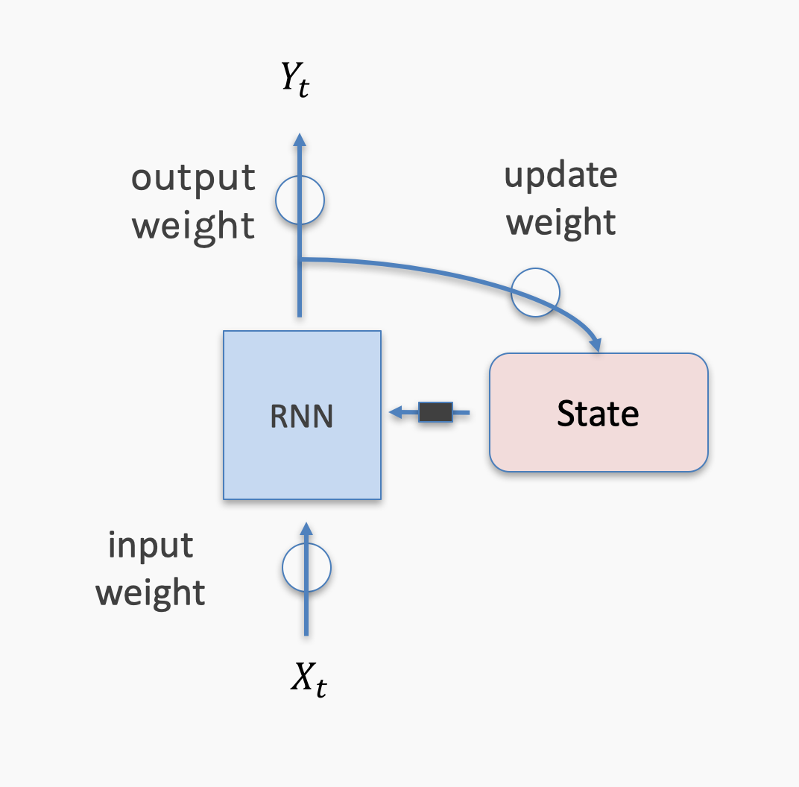
Image taken from A. Glassner, Deep Learning, Vol. 2: From Basics to Practice

Slide 35
Outline
Why RNNs
Main Concept of RNNs
More Details of RNNs
RNN training
Gated RNN

Slide 36
Backprop Through Time
For each input, unfold network for the sequence length T
Back-propagation: apply forward and backward pass on unfolded network
Memory cost: O(T)

Slide 37
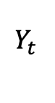
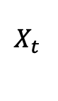
Backprop Through Time
$$Y_{t }$$
output
weight
update
weight
RNN
State
input
weight
$$X_{t }$$

Slide 38
Backprop Through Time
$$Y_{t }$$
output
weight
update
weight
RNN
State
$$X_{t }$$

Slide 39
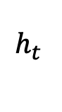
Backprop Through Time
$$Y_{t }$$
Output Weights: W
Update Weights: U
$$h_{t }$$
RNN
State
Input Weights: V
$$X_{t }$$

Slide 40
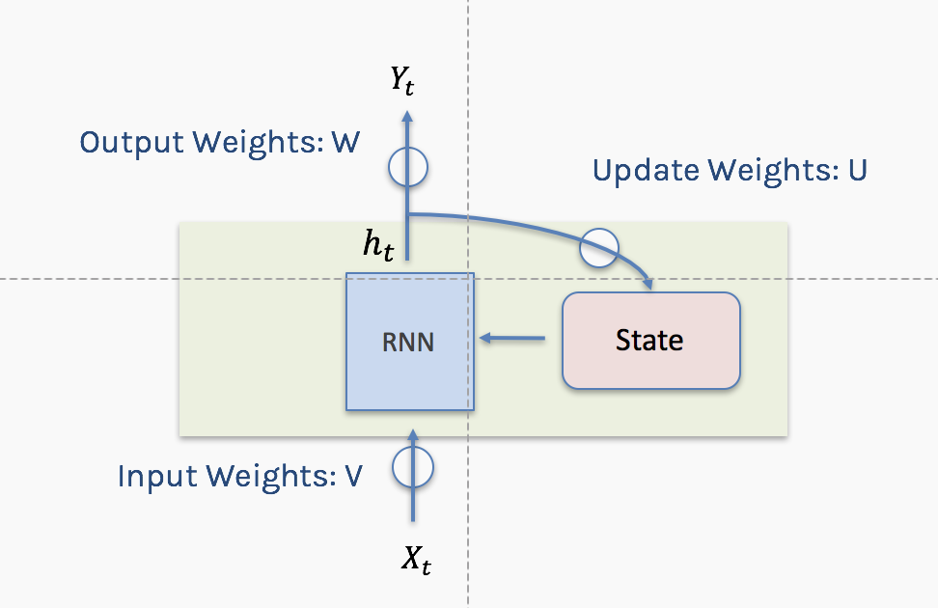
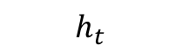
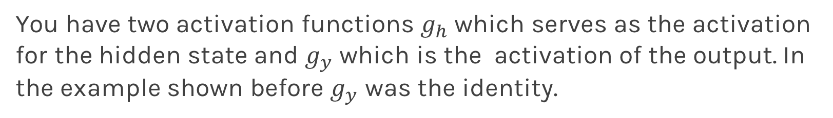
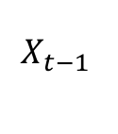
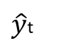
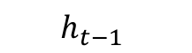
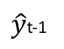
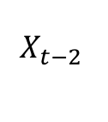
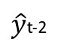
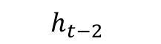
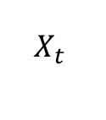
Backprop Through Time
$\hat{y}$t-2
$\hat{y}$t-1
$\hat{y}$t
W
W
W
U
U
U
$$h_{t−2}$$
$$h_{t−1}$$
$$h_{t}$$
V
V
V
$$X_{t−2 }$$
$$X_{t−1 }$$
$$X_{t }$$
You have two activation functions $g_{h}$ which serves as the activation for the hidden state and $g_{y}$ which is the activation of the output. In the example shown before $g_{y}$ was the identity.

Slide 41
Backprop Through Time
$\hat{y}$t-2
$\hat{y}$t-1
$\hat{y}$t
W
W
W
U
U
U
$$h_{t−2}$$
$$h_{t−1}$$
$$h_{t}$$
V
V
V
$$X_{t−2 }$$
$$X_{t−1 }$$
$$X_{t }$$

Slide 42
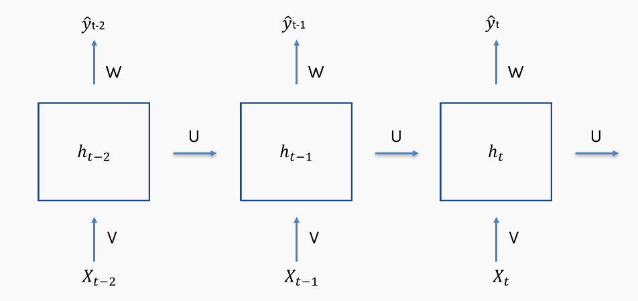
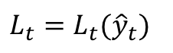
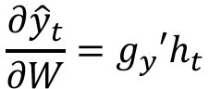
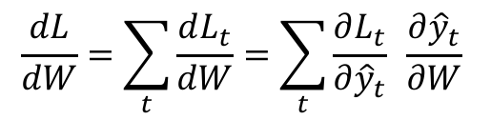
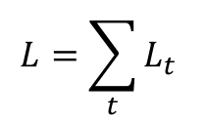
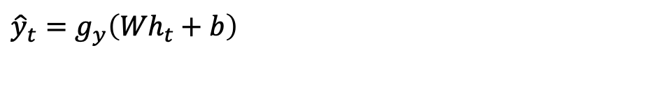
Backprop Through Time
$${\hat{y}}_{t}=g_{y}\left({Wh}_{t}+b\right)$$
$$L=\sum_{t}{L_{t}}$$
$$L_{t}=L_{t}({\hat{y}}_{t})$$
$$\frac{dL}{dW}=\sum_{t}{\frac{dL_{t}}{dW}}=\sum_{t}{\frac{∂L_{t}}{∂{\hat{y}}_{t}} \frac{∂{\hat{y}}_{t}}{∂W}}$$
$$\frac{∂{\hat{y}}_{t}}{∂W}=g_{y}′h_{t}$$

Slide 43
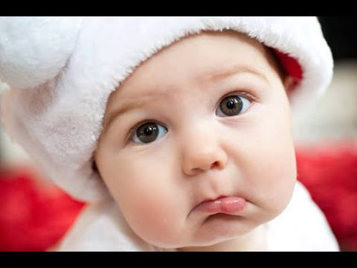

Slide 44
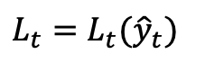
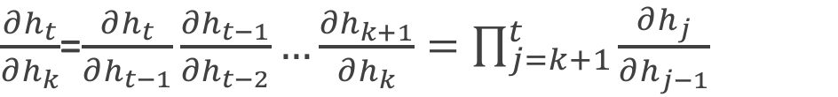
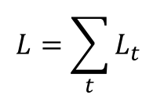
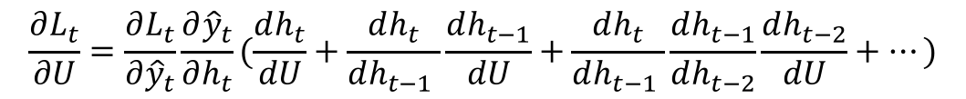



Backprop Through Time
$${\hat{y}}_{t}=g_{y}\left({Wh}_{t}+b\right)$$
$$h_{t}=g_{h}\left(Vx_{t}+Uh_{t−1}+b^{′}\right)$$
$${\hat{y}}_{t}=g_{y}({Wg}_{h}\left(Vx_{t}+Uh_{t−1}+b^{′}\right)+b)$$
$$L=\sum_{t}{L_{t}}$$
$$L_{t}=L_{t}({\hat{y}}_{t})$$
$$\frac{dL}{dU}=\sum_{t}{\frac{{∂L}_{t}}{∂{\hat{y}}_{t}}\frac{∂{\hat{y}}_{t}}{∂h_{t}}\frac{∂h_{t}}{∂U} }$$
$$\frac{∂h_{j}}{∂h_{j−1}}=g_{h}^{′}U$$
$\frac{∂h_{t}}{∂U}$=$\sum_{k=1}^{t}{\frac{∂h_{t}}{∂h_{k}}\frac{∂h_{k}}{∂U}}$
$\frac{∂h_{t}}{∂h_{k}}$=$\frac{∂h_{t}}{∂h_{t−1}}\frac{∂h_{t−1}}{∂h_{t−2}}…\frac{∂h_{k+1}}{∂h_{k}}=\prod_{j=k+1}^{t}{\frac{∂h_{j}}{∂h_{j−1}}}$
$$\frac{∂L_{t}}{∂U}=\frac{∂L_{t}}{∂{\hat{y}}_{t}}\frac{∂{\hat{y}}_{t}}{∂h_{t}}(\frac{dh_{t}}{dU}+\frac{dh_{t}}{dh_{t−1} }\frac{dh_{t−1}}{dU}+\frac{dh_{t}}{dh_{t−1} }\frac{dh_{t−1}}{dh_{t−2}}\frac{dh_{t−2}}{dU}+…)$$

Slide 45



Gradient Clipping
Prevents exploding gradients
Clip the norm of gradient before update.
For some derivative $g$, and some threshold u
$$if \left\|g\right\|>u$$
$$g⟵\frac{gu}{\left\|g\right\|}$$

Slide 46

Gradient Clipping

Slide 47
Outline
Why RNNs
Main Concept of RNNs
More Details of RNNs
RNN training
Gated RNN

Slide 48
Long-term Dependencies
Unfolded networks can be very deep
Long-term interactions are given exponentially smaller weights than small-term interactions
Gradients tend to either vanish or explode

Slide 49
Long Short-Term Memory
Handles long-term dependencies
Leaky units where weight on self-loop α is context-dependent
Allow network to decide whether to accumulate or forget past info

Slide 50

Notation
Using conventional and convenient notation
$$Y_{t }$$
$$X_{t }$$

Slide 51


Simple RNN again
$$Y_{t }$$
σ
W
$$h_{t }$$
State
σ
+
U
V
$$X_{t }$$

Slide 52
Simple RNN again
$$Y_{t }$$
σ
W
$$h_{t }$$
State
σ
+
U
V
$$X_{t }$$

Slide 53


Simple RNN again: Memories
$$Y_{t }$$
σ
W
$$h_{t }$$
State
σ
+
U
V
$$X_{t }$$

Slide 54
Simple RNN again: Memories - Forgetting
$$Y_{t }$$
σ
W
$$h_{t }$$
State
σ
+
U
V
$$X_{t }$$

Slide 55
Simple RNN again: New Events
$$Y_{t }$$
σ
W
$$h_{t }$$
State
σ
+
U
V
$$X_{t }$$

Slide 56
Simple RNN again: New Events Weighted
$$Y_{t }$$
σ
W
$$h_{t }$$
State
σ
+
U
V
$$X_{t }$$

Slide 57
Simple RNN again: Updated memories
$$Y_{t }$$
σ
W
$$h_{t }$$
State
σ
+
U
V
$$X_{t }$$

Slide 58
Ref
[Chen17b] Qiming Chen, Ren Wu, “CNN Is All You Need”, arXiv 1712.09662, 2017. https://arxiv.org/abs/1712.09662
[Chu17] Hang Chu, Raquel Urtasun, Sanja Fidler, “Song From PI: A Musically Plausible Network for Pop Music Generation”, arXiv preprint, 2017. https://arxiv.org/abs/1611.03477
[Johnson17] Daniel Johnson, “Composing Music with Recurrent Neural Networks”, Heahedria, 2017. http://www.hexahedria.com/2015/08/03/ composing-music-with-recurrent-neural-networks/
[Deutsch16b] Max Deutsch, “Silicon Valley: A New Episode Written by AI”, Deep Writing blog post, 2017. https://medium.com/deep-writing/ silicon-valley-a-new-episode-written-by-ai-a8f832645bc2
[Fan16] Bo Fan, Lijuan Wang, Frank K. Soong, Lei Xie “Photo-Real Talking Head with Deep Bidirectional LSTM”, Multimedia Tools and Applications, 75(9), 2016. https://www.microsoft.com/en-us/research/wp-content/uploads/2015/04/icassp2015_fanbo_1009.pdf

Slide 59
Continue on Wednesday

Slide 60






RNN
Is it raining? We build an RNN to the probability if it is raining:
0.3
0.1
0.1
0.4
0.6
-------
-------
-------
dog barking
$$\text{dog} \text{barking}$$
$$\text{white} \text{shirt}$$
$$\text{white} \text{shirt}$$
$$\text{apple} \text{pie}$$
$$\text{apple} \text{pie}$$
$$\text{knee} \text{hurts}$$
RNN
RNN
RNN
RNN
RNN
dog barking
$$\text{white} \text{shirt}$$
$$\text{apple} \text{pie}$$
$$\text{knee} \text{hurts}$$
get dark

Slide 61












RNN + Memory
0.3
0.1
0.1
0.4
0.6
-------
-------
-------
dog barking
$$\text{dog} \text{barking}$$
$$\text{white} \text{shirt}$$
$$\text{white} \text{shirt}$$
$$\text{apple} \text{pie}$$
$$\text{apple} \text{pie}$$
$$\text{knee} \text{hurts}$$
RNN
RNN
RNN
RNN
RNN
dog barking
$$\text{white} \text{shirt}$$
$$\text{apple} \text{pie}$$
$$\text{knee} \text{hurts}$$
get dark
0.3
0.1
0.1
0.6
0.9
-------
-------
-------
dog barking
$$\text{dog} \text{barking}$$
$$\text{white} \text{shirt}$$
$$\text{dog} \text{barking}$$
$$\text{apple} \text{pie}$$
$$\text{dog} \text{barking}$$
$$\text{knee} \text{hurts}$$
RNN
RNN
RNN
RNN
RNN
dog barking
$$\text{white} \text{shirt}$$
$$\text{apple} \text{pie}$$
$$\text{knee} \text{hurts}$$
get dark

Slide 62






RNN + Memory + Output
0.3
0.1
0.1
0.6
0.9
-------
-------
-------
dog barking
$$\text{dog} \text{barking}$$
$$\text{white} \text{shirt}$$
$$\text{dog} \text{barking}$$
$$\text{apple} \text{pie}$$
$$\text{dog} \text{barking}$$
$$\text{knee} \text{hurts}$$
RNN
RNN
RNN
RNN
RNN
dog barking
$$\text{white} \text{shirt}$$
$$\text{apple} \text{pie}$$
$$\text{knee} \text{hurts}$$
get dark

Slide 63

LSTM: Long short term memory

Slide 64


Before to really understand LSTM lets see the big picture …
Output Gate
Cell State
Input Gate
Forget Gate

Slide 65
Before to really understand LSTM lets see the big picture …
LSTM are recurrent neural network with a cell and a hidden state, boths of these are updated in each step and can be thought as memories.
Cell states work as a long term memory and the updates depends on the relation between the hidden state in t -1 and the input.
The hidden state of the next step is a transformation of the cell state and the output (which is the section that is in general used to calculate our loss, ie information that we want in a short memory).

Slide 66









Let's think about my cell state
Let's predict if i will help you in the homework in time t

Slide 67









Forget Gate
The forget gate tries to estimate what features of the cell state should be forgotten.
Erase everything!

Slide 68








The input gate layer works in a similar way that the forget layer, the input gate layer estimate the degree of confidence of and is a new estimation of the cell state.
Input Gate
Let’s say that my input gate estimation is:

Slide 69

Cell state
After the calculation of forget gate and input gate we can update our cell state.
69

Slide 70





Output gate
The output gate layer is calculated using the information of the input x in time t and hidden state of the last step.
It is important to notice that hidden state used in the next step is obtained using the output gate layer which is usually the function that we optimize.

Slide 71







wcct! = we can calculate this!
To optimize my parameters i basically need to do:
Let’s calculate all the derivatives in some time t!
wcct!
wcct!
wcct!
wcct!
So… every derivative is wrt the cell state or the hidden state

Slide 72



Let’s calculate the cell state and the hidden state

Slide 73

RNN Structures
$$Y_{t }$$
The one to one structure is useless.
It takes a single input and it produces a single output.
Not useful because the RNN cell is making little use of its unique ability to remember things about its input sequence
$$X_{t }$$
one to one

Slide 74


RNN Structures (cont)
$$Y_{t }$$
﻿The many to one structure reads in a sequence and gives us back a single value.
Example: Sentiment analysis, where the network is given a piece of text and then reports on some quality inherent in the writing. A common example is to look at a movie review and determine if it was positive or negative.
$$X_{t−2 }$$
$$X_{t−1 }$$
$$X_{t }$$
many to one

Slide 75




RNN Structures (cont)
$$Y_{t−2 }$$
$$Y_{t−1 }$$
$$Y_{t }$$
The one to many takes in a single piece of data and produces a sequence.
For example we give it the starting note for a song, and the network produces the rest of the melody for us.
$$X_{t−2 }$$
one to many

Slide 76


RNN Structures (cont)
$$Y_{t−2 }$$
$$Y_{t−1 }$$
$$Y_{t }$$
﻿The many to many structures are in some ways the most interesting. ﻿used for machine translation.
Example: Predict if it will rain given some inputs.
$$X_{t−2 }$$
$$X_{t−1 }$$
$$X_{t }$$
many to many

Slide 77
RNN Structures (cont)
$$Y_{t−1 }$$
$$Y_{t }$$
This form of many to many can be used for machine translation.
For example, the English sentence: “The black dog jumped over the cat”
In Italian as:
“Il cane nero saltò sopra il gatto”
In the Italia, the adjective “nero” (black) follows the noun “cane” (dog), so we need to have some kind of buffer so we can produce the words in their proper English.
$$X_{t−2 }$$
$$X_{t−1 }$$
many to many

Slide 78
Bidirectional
LSTM and RNN are designed to analyze sequence of values.
For example: ﻿Patrick said he needs a vacation.
he here means Patrick and we know this because Patrick was before the word he.
However consider the following sentence:
He needs to work more, Pavlos said about Patrick.
Bidirectional RNN or BRNN or bidirectional LSTM or BLSTM when using LSTM units.

Slide 79





Bidirectional (cond)
$$Y_{t−2 }$$
$$Y_{t−1 }$$
$$Y_{t }$$
﻿symbol for a BRNN
$$Y_{t }$$
previous state
previous state
$$X_{t }$$
$$X_{t−2 }$$
$$X_{t−1 }$$
$$X_{t }$$

Slide 80
Deep RNN
LSTM units can be arranged in layers, so that each the output of each unit is the input to the other units. This is called a deep RNN, where the adjective “deep” refers to these multiple layers.
Each layer feeds the LSTM on the next layer
First time step of a feature is fed to the first LSTM, which processes that data and produces an output (and a new state for itself).
That output is fed to the next LSTM, which does the same thing, and the next, and so on.
Then the second time step arrives at the first LSTM, and the process repeats.

Slide 81






Deep RNN
$$Y_{ }$$
$$Y_{t−2 }$$
$$Y_{t−1 }$$
$$Y_{t }$$
$$Y_{t+1 }$$
$$Y_{t+2 }$$
$$X_{ }$$
$$X_{t−2 }$$
$$X_{t−1 }$$
$$X_{t }$$
$$X_{t+1 }$$
$$X_{t+2 }$$

Slide 82
Skip Connections
Add additional connections between units d time steps apart
Creating paths through time where gradients neither vanish or explode
t-1
t
t+1

Slide 83
Leaky Units
Linear self-connections
Maintain cell state: running average of past hidden activations

Slide 84

Standard RNN
colah.github.io

Slide 85
Leaky Unit
✕
colah.github.io

